Slide 1

Public Transport
Spatial Analysis with R
Chia-Jung (Robert) Yeh
葉家榮
2025.10

Slide 2


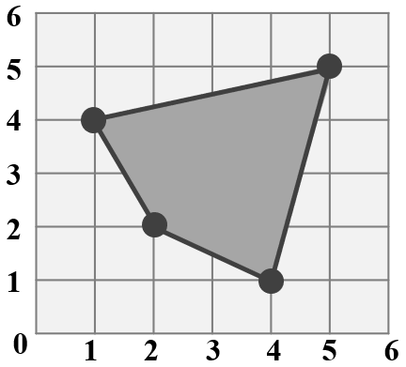
Build Geographic Data
POINT (3 3)
Recap WKT…
Point
LineString
Polygon
MultiPoint
MultiLineString
MultiPolygon
GeometryCollection
LINESTRING (1 4, 3 3, 5 5)
POLYGON ((1 4, 2 2, 4 1, 5 5, 1 4))

Slide 3
Simple Feature
Simple Features
(sf)
Spatial data (e.g., us_states)
Geometry + Attribute
Simple Feature Columns
(sfc)
A geometry column
Simple Feature Geometries
(sfg)
A geometry element

Slide 4
Simple Feature Geometries (sfg)
Geometry | Simple Feature Geometries | Data Structure
Point | st_point() | c( )
LineString | st_linestring() | rbind(c( ), ……, c( ))
Polygon | st_polygon() | list(rbind(c( ), ……, c( )))
MultiPoint | st_multipoint() | rbind(c( ), ……, c( ))
MultiLineString | st_multilinestring() | list(rbind(c( ), ……, c( )), ……, rbind(c( ), ……, c( )))
MultiPolygon | st_multipolygon() | list(list(rbind(c( ), ……, c( ))), ……, list(rbind(c( ), ……, c( ))))

Slide 5
Simple Feature Geometries (sfg)
list
v3=list(rbind(c(1, 2), c(3, 4)), rbind(c(5, 6), c(7, 8)))
v3
## [[1]]
## [,1] [,2]
## [1,] 1 2
## [2,] 3 4
## [[2]]
## [,1] [,2]
## [1,] 5 6
## [2,] 7 8
class(v3)
## [1] "list"
Recap R Data Structure
vector
matrix
v1=c(1, 2)
v1
## [1] 1 2
class(v1)
## [1] "numeric"
v2=rbind(c(1, 2), c(3, 4))
v2
## [,1] [,2]
## [1,] 1 2
## [2,] 3 4
class(v2)
## [1] "matrix" "array"
The first matrix in the list
The second matrix in the list

Slide 6
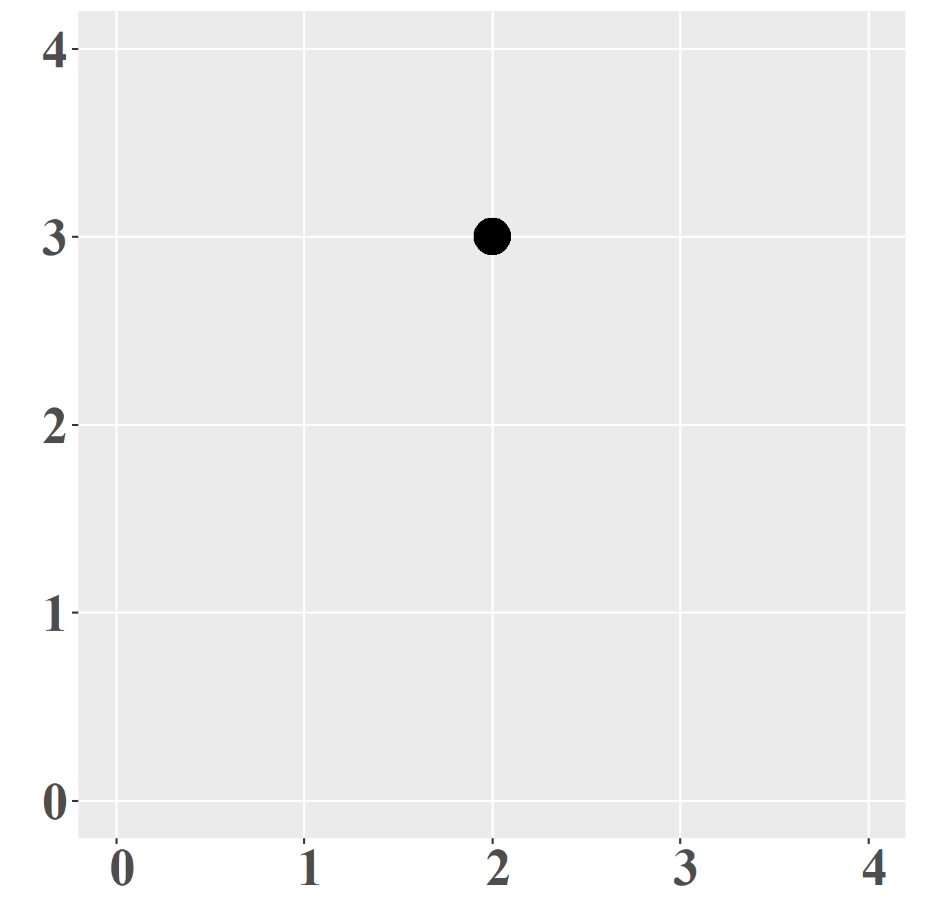
Simple Feature Geometries (sfg)
POINT
st_point(c(x, y))
# setting a vector c(x, y)
point_eg=st_point(c(2, 3))
# view point_eg
point_eg
## POINT (2 3)
ggplot()+
geom_sf(data=point_eg)
# check data type of point_eg
class(point_eg)
## [1] "XY" "POINT" "sfg"

Slide 7
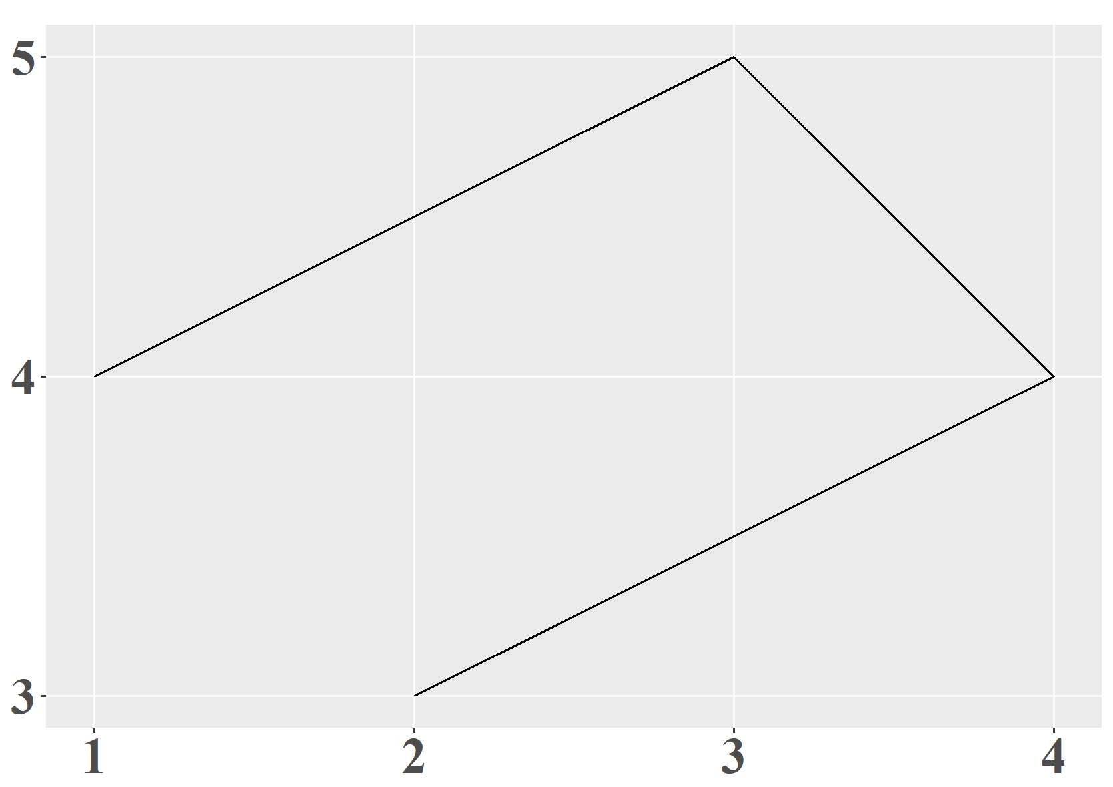
Simple Feature Geometries (sfg)
LINESTRING
st_linestring(rbind(c(x1, y1), c(x2, y2), c(x3, y3), ……)))
# setting a matrix using rbind()
linestring_eg=st_linestring(rbind(c(2,3), c(4,4), c(3,5), c(1,4)))
# view linestring_eg
linestring_eg
## LINESTRING (2 3, 4 4, 3 5, 1 4)
# check data type of linestring_eg
class(linestring_eg)
## [1] "XY" "LINESTRING" "sfg"

Slide 8
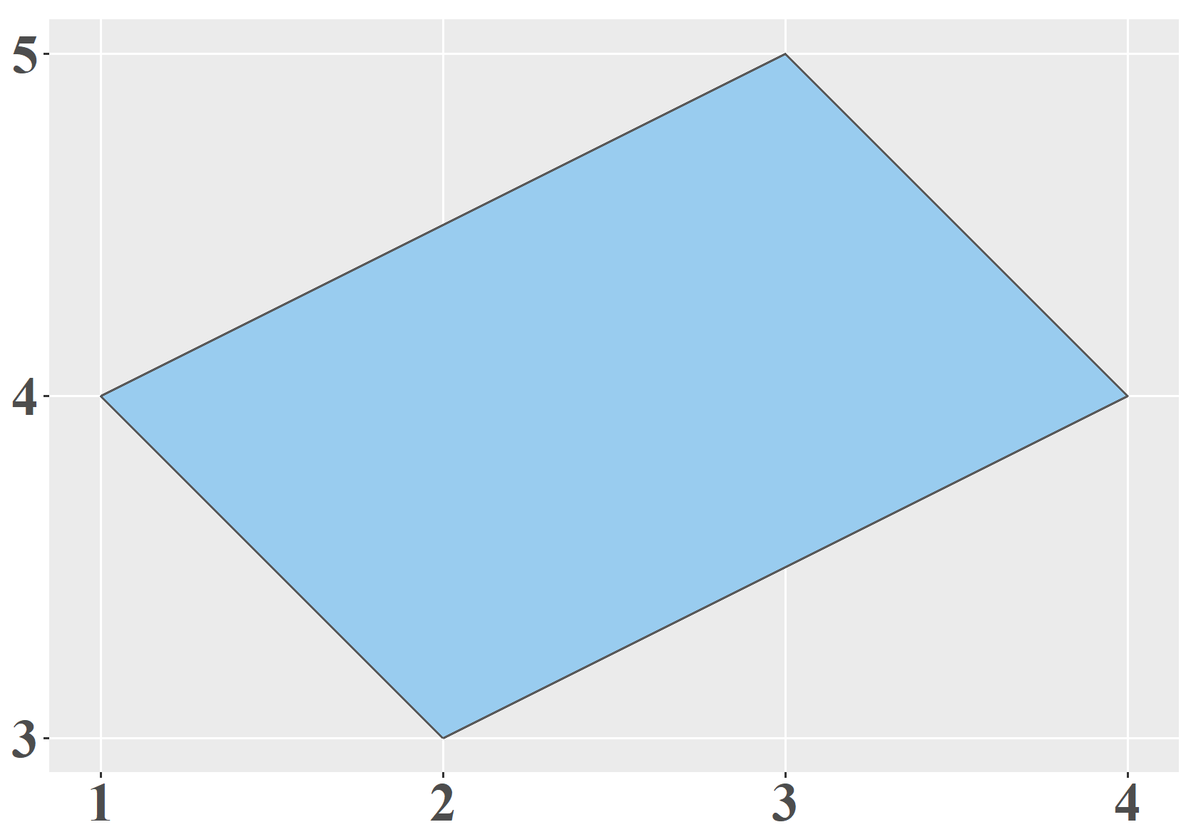
Simple Feature Geometries (sfg)
POLYGON
st_polygon(list(rbind(c(x1, y1), c(x2, y2), ……, c(x1, y1)))))
# setting a list using list()
polygon_eg=st_polygon(list(rbind(c(2,3), c(4,4), c(3,5), c(1,4), c(2,3))))
# view polygon_eg
polygon_eg
## POLYGON ((2 3, 4 4, 3 5, 1 4, 2 3))
The first and last point should be identical!
# check data type of polygon_eg
class(polygon_eg)
## [1] "XY" "POLYGON" "sfg"

Slide 9
Simple Feature Columns (sfc)
st_sfc() build simple feature columns
Simple Feature Columns
What is Column ?
# build sfg
point1=st_point(c(3, 5))
point2=st_point(c(2, 6))
point3=st_point(c(1, 4))
# build sfc
point123=st_sfc(point1, point2, point3)
class(us_states$geometry)
## [1] "sfc_MULTIPOLYGON" "sfc"
geometry column
# check data type of point123
class(point123)
## [1] "sfc_POINT" "sfc"

Slide 10
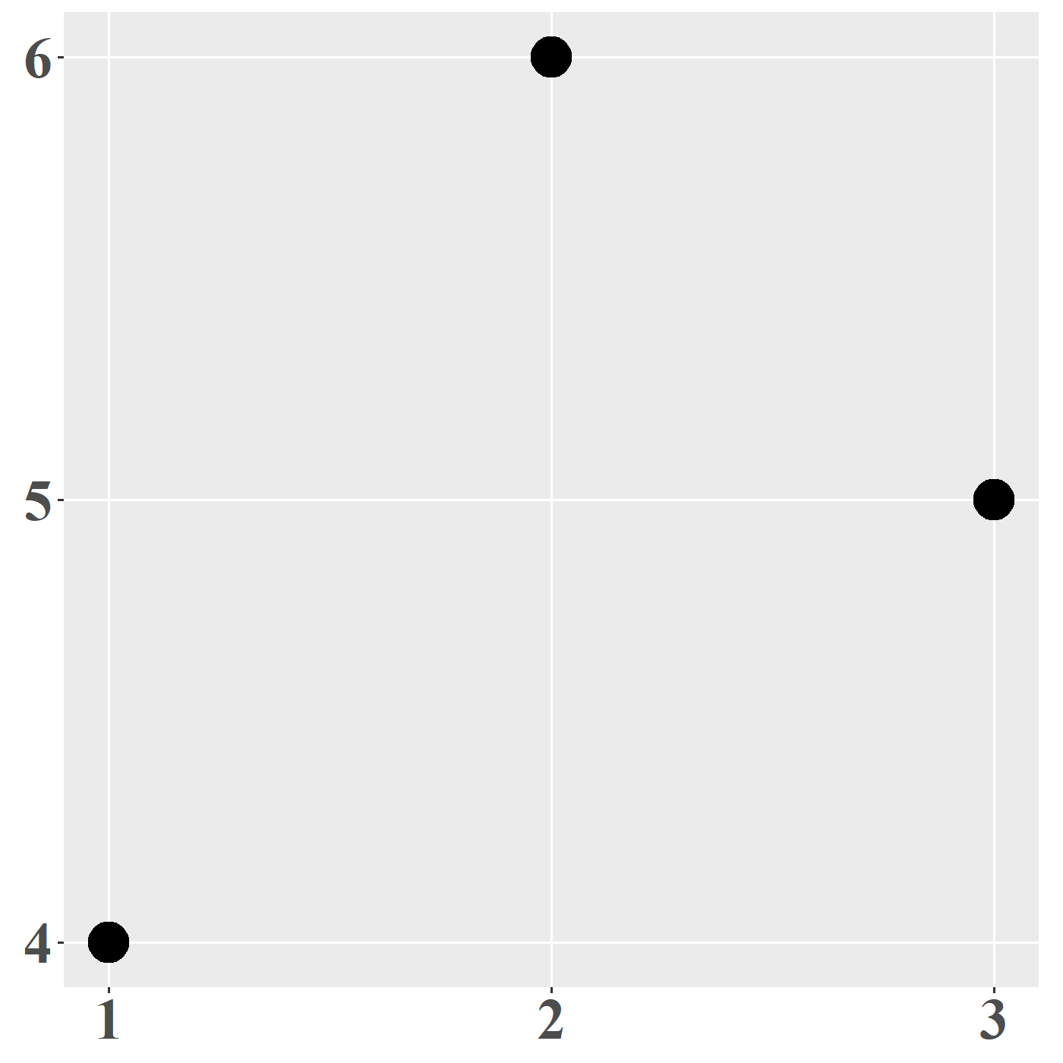
Simple Feature Columns (sfc)
st_sfc() build simple feature columns
# view point123
point123
## Geometry set for 3 features
## Geometry type: POINT
## Dimension: XY
## Bounding box: xmin: 1 ymin: 4 xmax: 3 ymax: 6
## CRS: NA
## POINT (3 5)
## POINT (2 6)
## POINT (1 4)
Currently, there is no CRS!

Slide 11
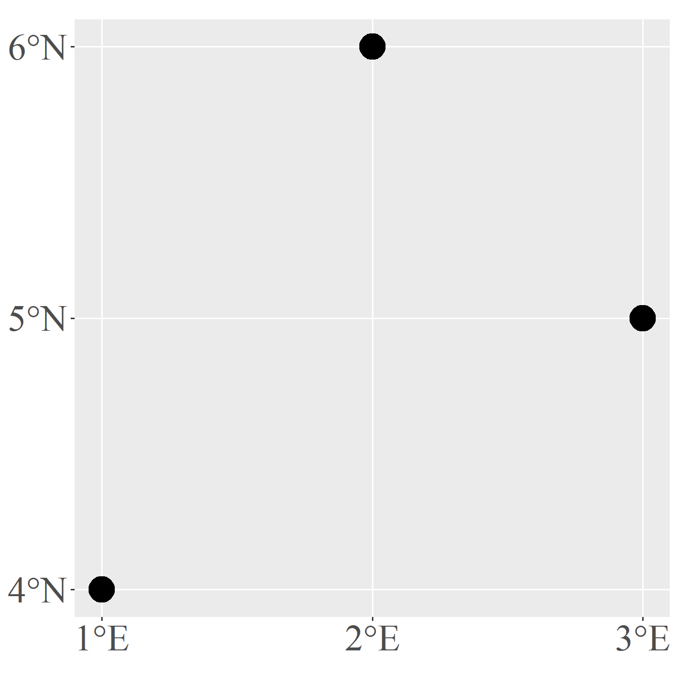
Simple Feature Columns (sfc)
# build sfc and specify CRS
point123=st_sfc(point1, point2, point3, crs=4326)
# view point123
point123
## Geometry set for 3 features
## Geometry type: POINT
## Dimension: XY
## Bounding box: xmin: 1 ymin: 4 xmax: 3 ymax: 6
## Geodetic CRS: WGS 84
## POINT (3 5)
## POINT (2 6)
## POINT (1 4)
st_sfc() build simple feature columns, and specify CRS used.
GCS
This time, units have been included when plotting the map!

Slide 12

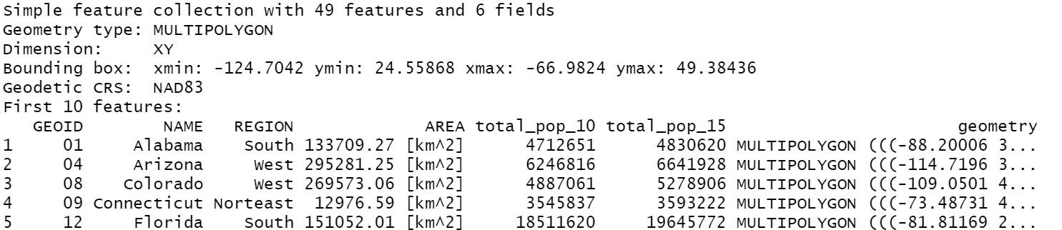
Simple Features (sf)
sf: an entire spatial data
(sfc)
(sf)
us_states
Simple feature geometries (sfg)
Simple features (sf)
Simple feature columns (sfc)

Slide 13
Simple Features (sf)
How to construct sf data?
(sfc)
(sf)
GEOMETRY=st_sfc(……, crs=)
GEODATA=data.frame(ATTRIBUTE, GEOMETRY)
SFDATA=st_sf(GEODATA, crs=)
Construct a simple feature columns
Combine geometry and attribute
Convert the data into sf data

Slide 14
Simple Features (sf)
Geometry Data
District Office | Longtitude | Latitude | Address | Telephone
東區區公所 | 120.973255 | 24.805162 | 民族路40號 | 03-5218231
北區區公所 | 120.970314 | 24.816374 | 國華街69號 | 03-5152525
香山區區公所 | 120.942268 | 24.794044 | 育德街188號 | 03-5307105
Construct sf data
Step 1:
# construct the geometry data
office_geom=st_sfc(
st_point(c(120.973255, 24.805162)), # lat and lon of 東區區公所
st_point(c(120.970314, 24.816374)), # lat and lon of 北區區公所
st_point(c(120.942268, 24.794044)), # lat and lon of 香山區區公所
crs=4326) # set CRS
# check data type of office_geom
class(office_geom)
## [1] "sfc_POINT" "sfc"

Slide 15
Simple Features (sf)
Attribute Data
District Office | Longtitude | Latitude | Address | Telephone
東區區公所 | 120.973255 | 24.805162 | 民族路40號 | 03-5218231
北區區公所 | 120.970314 | 24.816374 | 國華街69號 | 03-5152525
香山區區公所 | 120.942268 | 24.794044 | 育德街188號 | 03-5307105
Construct sf data
Step 2:
# construct the attribute data, and attach the geometry data
office=data.frame(
name=c("東區","北區","香山區"), # district
address=c("民族路40號", "國華街69號", "育德街188號"), # address
phone=c("03-5218231", "03-5152525", "03-5307105"), # telephone
office_geom # geometry data
)
Attribute
Geometry
# check data type of office
class(office)
## [1] "data.frame"
Still a Data Frame!!

Slide 16
Simple Features (sf)
Construct sf data
Step 3:
# convert the office data to sf
office=st_sf(office)
# check data type again
class(office)
## [1] "sf" "data.frame"

Slide 17
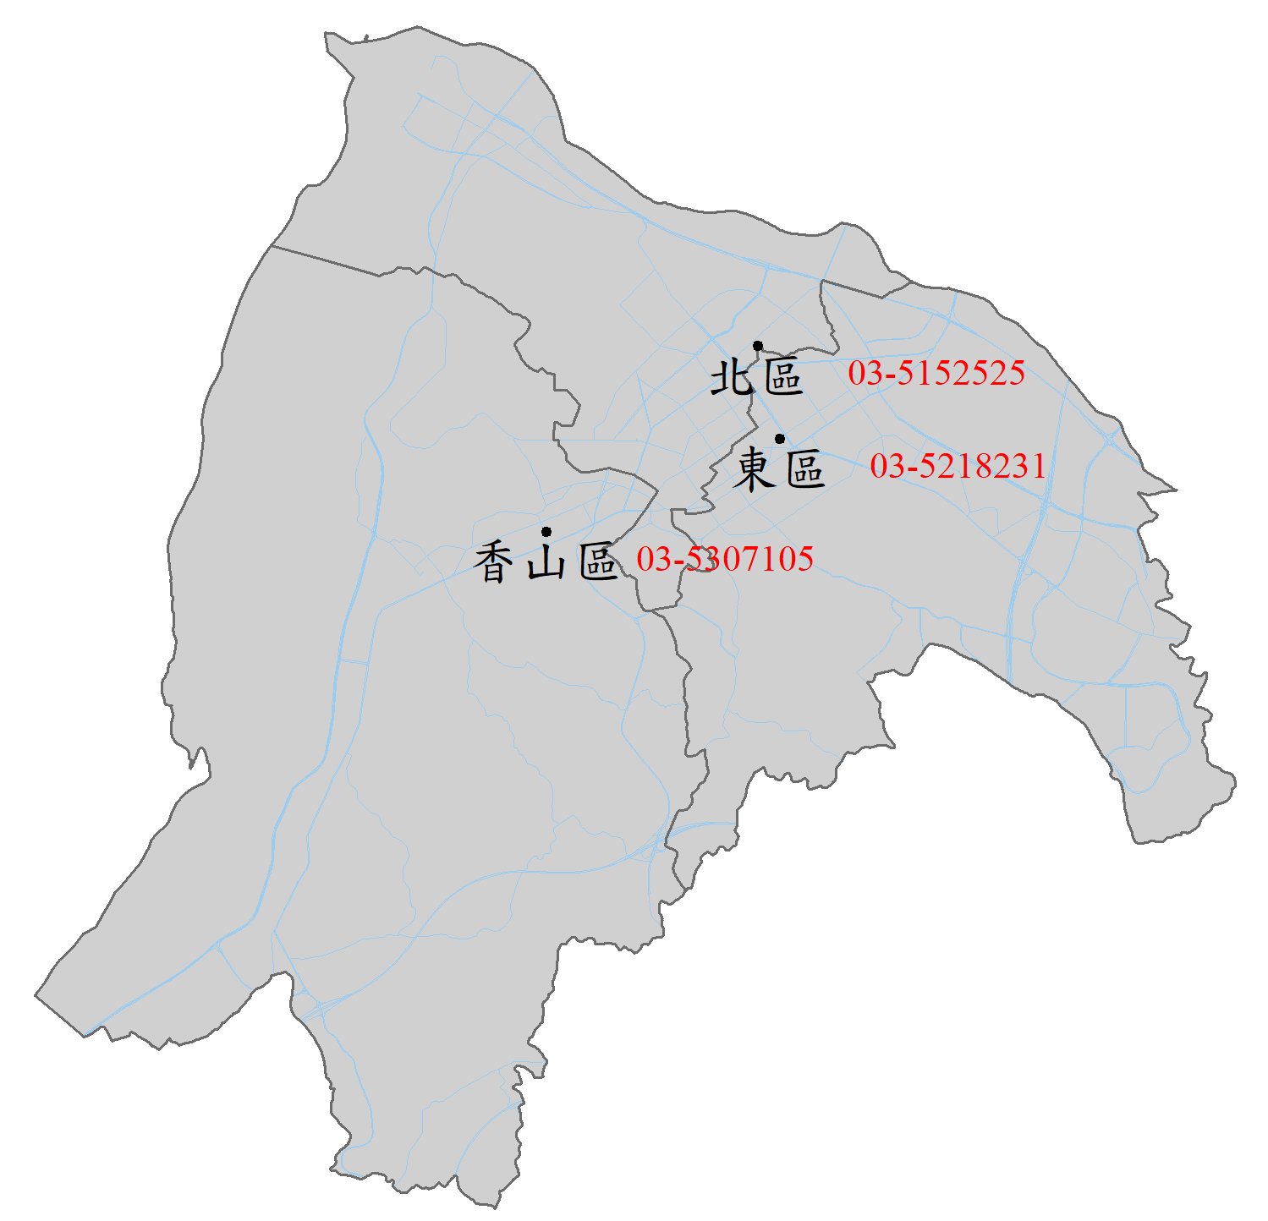
Simple Features (sf)
Construct sf data
# view office data
office
## Simple feature collection with 3 features and 3 fields
## Geometry type: POINT
## Dimension: XY
## Bounding box: xmin: 120.9423 ymin: 24.79404 xmax: 120.9733 ymax: 24.81637
## Geodetic CRS: WGS 84
## name address phone geometry
## 1 東區 民族路40號 03-5218231 POINT (120.9733 24.80516)
## 2 北區 國華街69號 03-5152525 POINT (120.9703 24.81637)
## 3 香山區 育德街188號 03-5307105 POINT (120.9423 24.79404)

Slide 18
Simple Features (sf)
We use st_sfc() to set CRS in the previous example.
How about setting in st_sf() function?
# construct the geometry data
office_geom=st_sfc(
st_point(c(120.973255, 24.805162)),
st_point(c(120.970314, 24.816374)),
st_point(c(120.942268, 24.794044)))
# construct the attribute data, and attach the geometry data
office=data.frame(
name=c("東區","北區","香山區"),
address=c("民族路40號", "國華街69號", "育德街188號"),
phone=c("03-5218231", "03-5152525", "03-5307105"),
office_geom
)
office=st_sf(office, crs=4326)
Identical Result!!

Slide 19
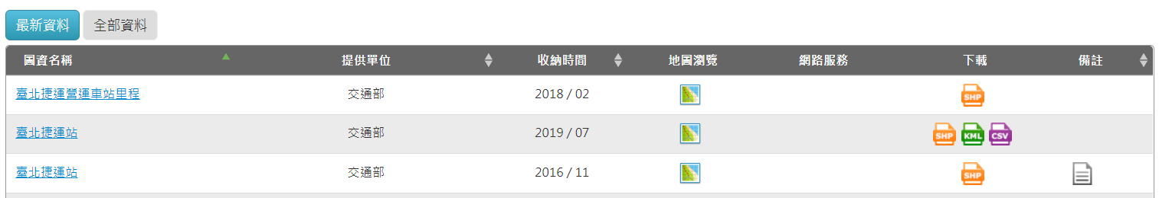
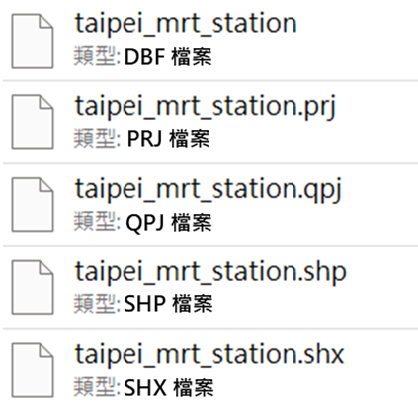
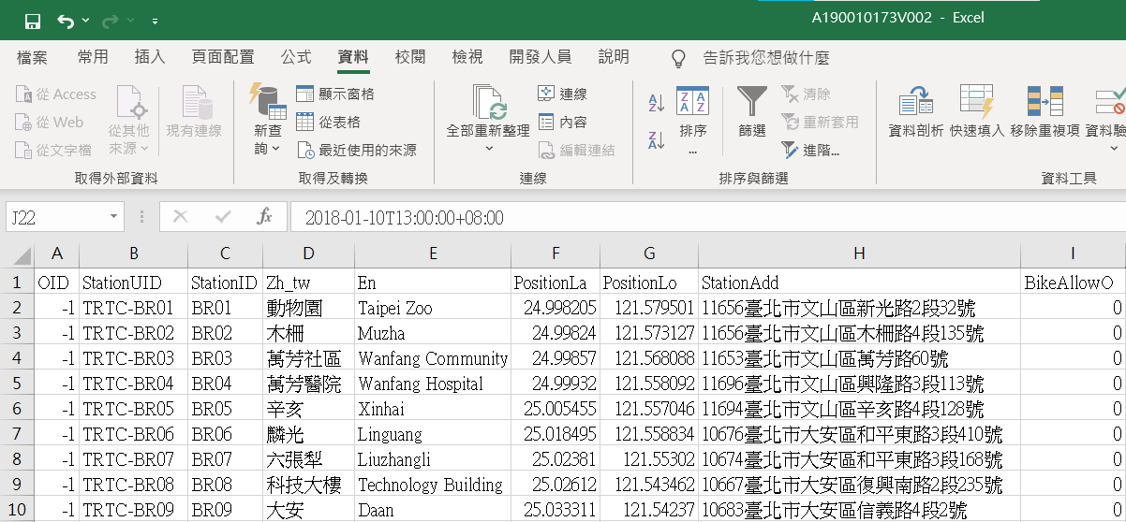
Read Shapefile
We spend time and efforts in constructing sf data manually,
but in practice…
Spatial data are saved and transferred in Shapefile or Text file (WKT).

Slide 20
Read Shapefile
Data Used
Please download data via following link:
https://github.com/ChiaJung-Yeh/Spatial-Analysis/raw/master/data.zip

Slide 21
Read Shapefile
Import Shapefile
Use data “taipei_map/taipei_village_map.shp”
# read data（relative location）
taipei_village_map1=read_sf("./data/taipei_map/taipei_village_map.shp")
# check data type
class(taipei_village_map1)
## [1] "sf" "tbl_df" "tbl" "data.frame"

Slide 22
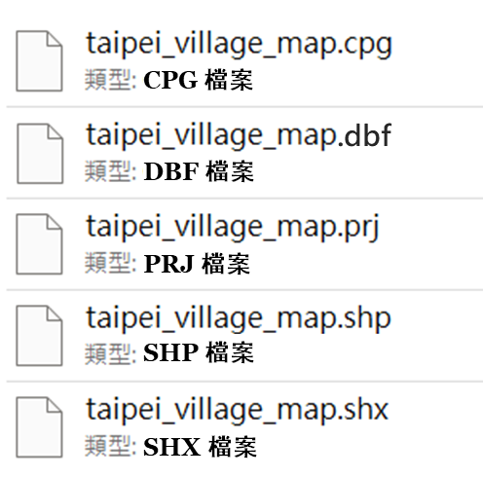
Read Shapefile
# view the first six data in taipei_village_map
head(taipei_village_map1)
## Simple feature collection with 6 features and 10 fields
## Geometry type: POLYGON
## Dimension: XY
## Bounding box: xmin: 305833.7 ymin: 2761906 xmax: 308529.2 ymax: 2764253
## Projected CRS: TWD97 / TM2 zone 121
## # A tibble: 6 x 11
## VILLCODE COUNTYNAME TOWNNAME VILLNAME VILLENG COUNTYID COUNTYCODE TOWNID
## <chr> <chr> <chr> <chr> <chr> <chr> <chr> <chr>
## 1 63000080031 臺北市 文山區 樟新里 Zhangxin ~ A 63000 A11
## 2 63000080037 臺北市 文山區 老泉里 Laoquan V~ A 63000 A11
## 3 63000080032 臺北市 文山區 樟腳里 Zhangjiao~ A 63000 A11
## 4 63000080041 臺北市 文山區 樟文里 Zhangwen ~ A 63000 A11
## 5 63000080043 臺北市 文山區 樟樹里 Zhangshu ~ A 63000 A11
## 6 63000080029 臺北市 文山區 順興里 Shunxing ~ A 63000 A11
## # ... with 3 more variables: TOWNCODE <chr>, PP <int>, geometry <POLYGON [m]>
Import Shapefile

Slide 23
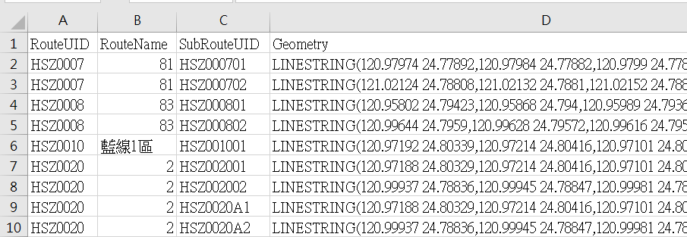
Read Text File
Import text file (WKT)

Slide 24
Read Text File
Import text file (WKT)
st_as_sfc("WKT")
# put WKT in st_as_sfc() function
point1=st_as_sfc("POINT (2 3)")
# view point1
point1
## Geometry set for 1 feature
## Geometry type: POINT
## Dimension: XY
## Bounding box: xmin: 2 ymin: 3 xmax: 2 ymax: 3
## CRS: NA
## POINT (2 3)
# check data type of point1
class(point1)
## [1] "sfc_POINT" "sfc"

Slide 25
Read Text File
Import text file (WKT)
st_as_sfc("WKT")
# construct the WKT in a vector
point2=c("POINT (2 3)", "POINT (4 5)", "POINT (6 7)")
# put WKT vector in st_as_sfc() function
point2=st_as_sfc(point2)
# view point2
point2
## Geometry set for 3 features
## Geometry type: POINT
## Dimension: XY
## Bounding box: xmin: 2 ymin: 3 xmax: 6 ymax: 7
## CRS: NA
## POINT (2 3)
## POINT (4 5)
## POINT (6 7)

Slide 26
Read Text File
Import text file (WKT)
Step1: Read Text File
Use data “csv_files/hsinchu_bus_route.csv”
# read csv data
hsinchu_bus_route=read.csv("./data/csv_files/hsinchu_bus_route.csv")
# check data type
class(hsinchu_bus_route)
## [1] "data.frame"

Slide 27
Read Text File
Import text file (WKT)
Step2: Build sfc
# put WKT column into st_as_sfc() function to construct sfc
hsinchu_bus_route$Geometry=st_as_sfc(hsinchu_bus_route$Geometry)
# check data type
class(hsinchu_bus_route)
## [1] "data.frame"
Still a Data Frame!!
# check data type of column Geometry in the data
class(hsinchu_bus_route$Geometry)
## [1] "sfc_LINESTRING" "sfc"

Slide 28
Read Text File
Import text file (WKT)
Step3: Build sf
# convert the data to sf, and set CRS
hsinchu_bus_route=st_sf(hsinchu_bus_route, crs=4326)
# check data type
class(hsinchu_bus_route)
## [1] "sf" "data.frame"

Slide 29
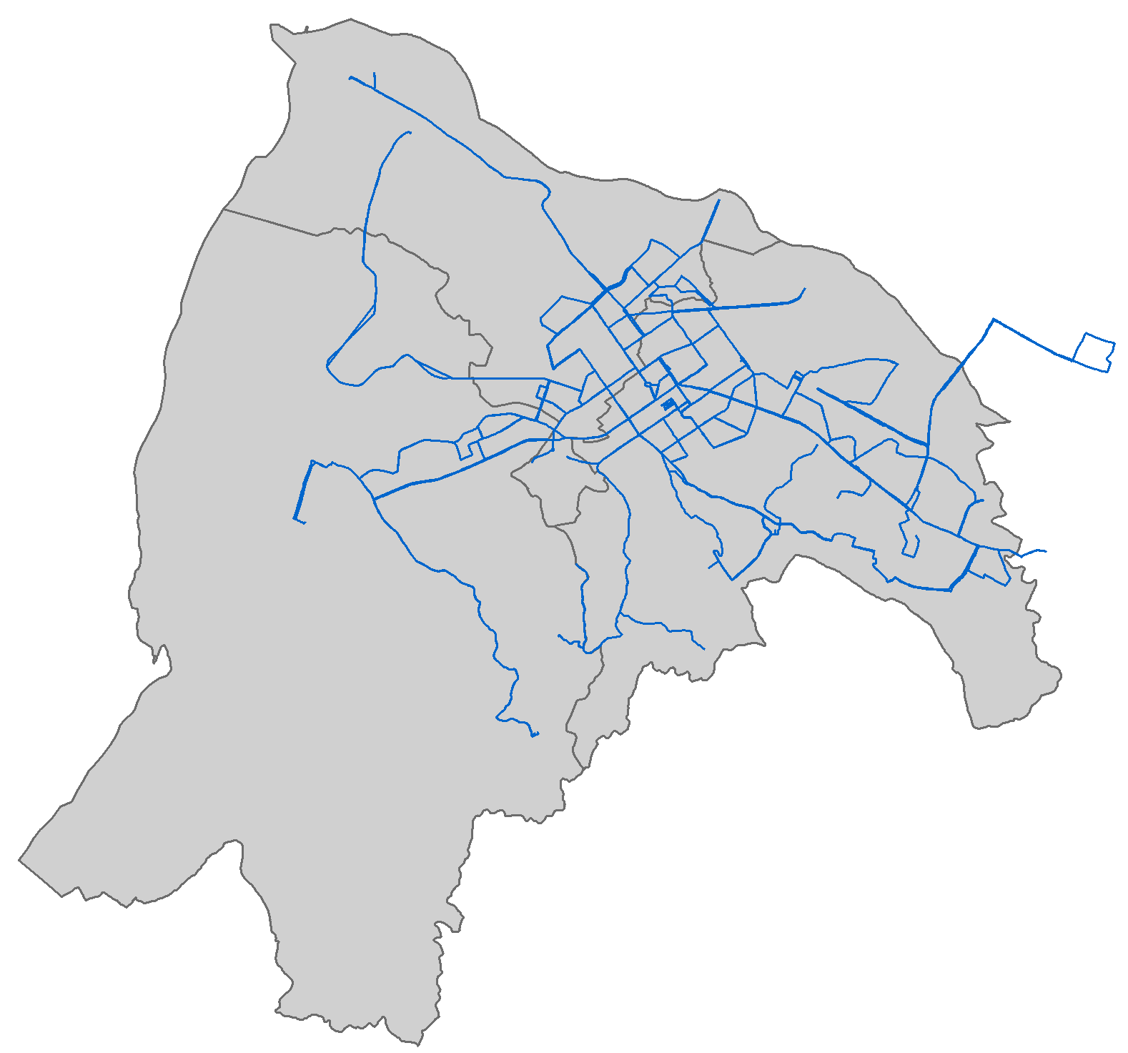
# view hsinchu_bus_route
hsinchu_bus_route
## Simple feature collection with 53 features and 3 fields
## Geometry type: LINESTRING
## Dimension: XY
## Bounding box: xmin: 120.9164 ymin: 24.75539 xmax: 121.0417 ymax: 24.84744
## Geodetic CRS: WGS 84
## First 10 features:
## RouteUID RouteName SubRouteUID Geometry
## 1 HSZ0007 81 HSZ000701 LINESTRING (120.9797 24.778...
## 2 HSZ0007 81 HSZ000702 LINESTRING (121.0212 24.788...
## 3 HSZ0008 83 HSZ000801 LINESTRING (120.958 24.7942...
## 4 HSZ0008 83 HSZ000802 LINESTRING (120.9964 24.795...
## 5 HSZ0010 藍線1區 HSZ001001 LINESTRING (120.9719 24.803...
## 6 HSZ0020 2 HSZ002001 LINESTRING (120.9719 24.803...
## 7 HSZ0020 2 HSZ002002 LINESTRING (120.9994 24.788...
## 8 HSZ0020 2 HSZ0020A1 LINESTRING (120.9719 24.803...
## 9 HSZ0020 2 HSZ0020A2 LINESTRING (120.9994 24.788...
## 10 HSZ0100 10 HSZ010001 LINESTRING (120.9705 24.801...
Read Text File
Import text file (WKT)

Slide 30
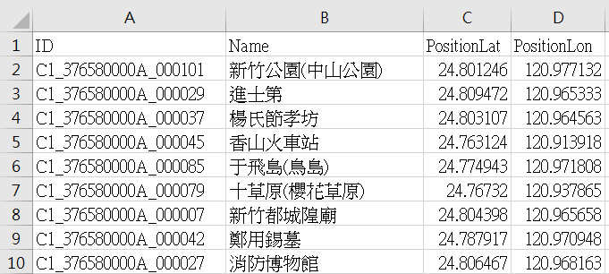
Read Text File
WKT text can be converted using st_as_sfc().
How about the data with latitude and longitude separated in two columns?
Import text file
(latitude and longitude）

Slide 31
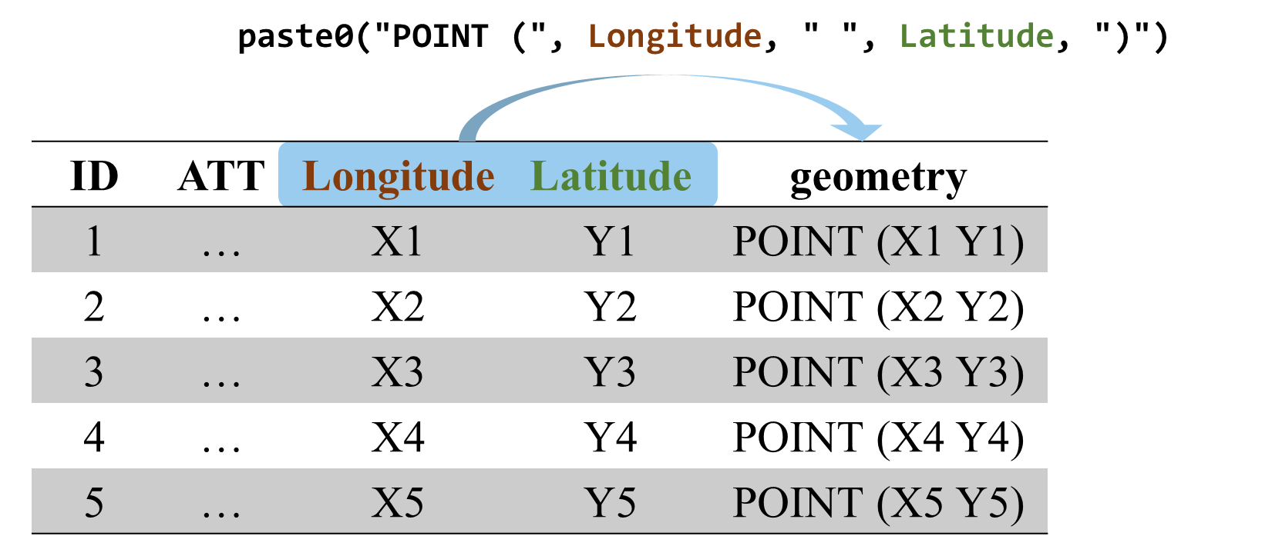
Read Text File
Import text file
(latitude and longitude）
Method 1
DATASF=mutate(DATA, geometry=paste0("POINT (", Longitude, " ", Latitude, ")"))
Method 2
DATASF$geometry=paste0("POINT (", DATASF$Longitude, " ", DATASF$Latitude, ")"))
Finally, convert the geometry text to sfc, and the entire data to sf!
DATASF$geometry=st_as_sfc(DATASF$geometry)
DATASF=st_sf(DATASF, crs=)

Slide 32
Read Text File
Import text file
(latitude and longitude）
Use data in “csv_files/hsinchu_scenicSpot.csv”
# read csv data
hsinchu_scenicSpot=read.csv("./data/csv_files/hsinchu_scenicSpot.csv")
# add WKT vector
hsinchu_scenicSpot=mutate(hsinchu_scenicSpot,
geometry=paste("POINT(", PositionLon, " ", PositionLat, ")"))

Slide 33
Read Text File
Import text file
(latitude and longitude）
# convert geometry to sfc
hsinchu_scenicSpot$geometry=st_as_sfc(hsinchu_scenicSpot$geometry)
# construct sf data
hsinchu_scenicSpot=st_sf(hsinchu_scenicSpot, crs=4326)
# check data type of hsinchu_scenicSpot
class(hsinchu_scenicSpot)
## [1] "sf" "data.frame"

Slide 34
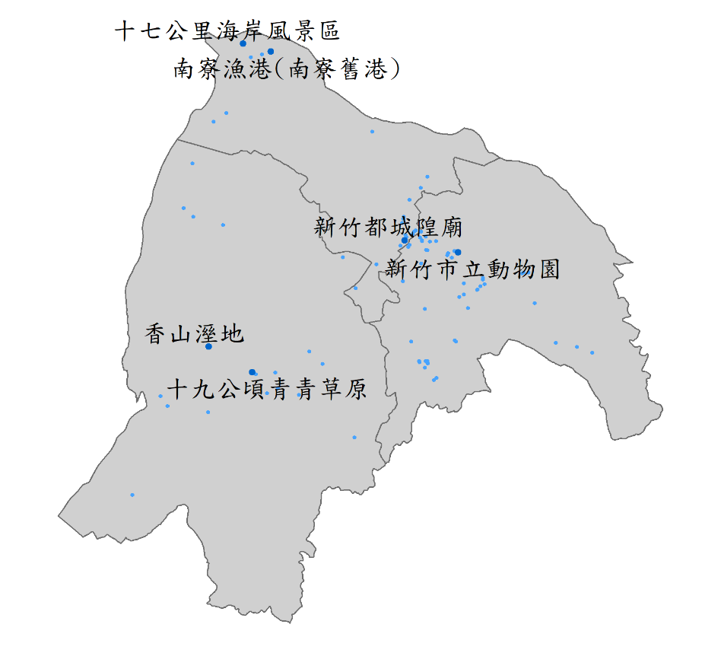
Read Text File
Import text file (latitude and longitude）
# view first six data of hsinchu_scenicSpot
head(hsinchu_scenicSpot)
## Simple feature collection with 6 features and 4 fields
## Geometry type: POINT
## Dimension: XY
## Bounding box: xmin: 120.9139 ymin: 24.76312 xmax: 120.9771 ymax: 24.80947
## Geodetic CRS: WGS 84
## ID Name PositionLat PositionLon geometry
## 1 C1_376580000A_000101 新竹公園(中山公園) 24.80125 120.9771 POINT (120.9771 24.80125)
## 2 C1_376580000A_000029 進士第 24.80947 120.9653 POINT (120.9653 24.80947)
## 3 C1_376580000A_000037 楊氏節孝坊 24.80311 120.9646 POINT (120.9646 24.80311)
## 4 C1_376580000A_000045 香山火車站 24.76312 120.9139 POINT (120.9139 24.76312)
## 5 C1_376580000A_000085 于飛島(鳥島) 24.77494 120.9718 POINT (120.9718 24.77494)
## 6 C1_376580000A_000079 十草原(櫻花草原) 24.76732 120.9379 POINT (120.9379 24.76732)

Slide 35
Read Text File
Import text file
(latitude and longitude）
Method 3 (A better way!!)
DATASF=st_as_sf(DATA, coords=c("Longitude", "Latitude"), crs=)
Example:
# construct sf data
hsinchu_scenicSpot=st_as_sf(hsinchu_scenicSpot, coords=c("PositionLon", "PositionLat"),
crs=4326)

Slide 36
st_crs(nz)
## Coordinate Reference System:
## User input: EPSG:2193
## wkt:
## PROJCS["NZGD2000 / New Zealand Transverse Mercator 2000",
## GEOGCS["NZGD2000",
## DATUM["New_Zealand_Geodetic_Datum_2000",
## SPHEROID["GRS 1980",6378137,298.257222101,
## AUTHORITY["EPSG","7019"]],
## TOWGS84[0,0,0,0,0,0,0],
## AUTHORITY["EPSG","6167"]],
## PRIMEM["Greenwich",0,
## AUTHORITY["EPSG","8901"]],
## UNIT["degree",0.0174532925199433,
## AUTHORITY["EPSG","9122"]],
## AUTHORITY["EPSG","4167"]],
## PROJECTION["Transverse_Mercator"],
## PARAMETER["latitude_of_origin",0],
## PARAMETER["central_meridian",173],
## PARAMETER["scale_factor",0.9996],
## PARAMETER["false_easting",1600000],
## PARAMETER["false_northing",10000000],
## UNIT["metre",1,
## AUTHORITY["EPSG","9001"]],
## AUTHORITY["EPSG","2193"]]
Check CRS
Check CRS using st_crs()
st_crs(nz)

Slide 37
Check CRS
Check CRS using st_crs()$
st_crs(nz)$
st_crs() Argument | Meanings | Data
 |  | us_states | nz | taipei_boundary
$Name | Name of CRS | NAD83 | NZGD2000 / New Zealand Transverse Mercator 2000 | TWD97 / TM2 zone 121
$epsg | EPSG Code | 4269 | 2193 | 3826
$IsGeographic | GCS or not | TRUE | FALSE | FALSE
$units | Unit of CRS | NULL | m | m

Slide 38
Transform CRS
# view nz_height
head(nz_height)
## Simple feature collection with 6 features and 2 fields
## Geometry type: POINT
## Dimension: XY
## Bounding box: xmin: 1204143 ymin: 5048309 xmax: 1389460 ymax: 5168749
## Projected CRS: NZGD2000 / New Zealand Transverse Mercator 2000
## t50_fid elevation geometry
## 1 2353944 2723 POINT (1204143 5049971)
## 2 2354404 2820 POINT (1234725 5048309)
## 3 2354405 2830 POINT (1235915 5048745)
## 4 2369113 3033 POINT (1259702 5076570)
## 5 2362630 2749 POINT (1378170 5158491)
## 6 2362814 2822 POINT (1389460 5168749)
Use st_transform() to convert CRS

Slide 39
Transform CRS
Use st_transform() to convert CRS
st_transform()
# convert CRS
nz_height_4326=st_transform(nz_height, crs=4326)
convert to EPSG:4326

Slide 40
Transform CRS
# view nz_height_4326
head(nz_height_4326)
## Simple feature collection with 6 features and 2 fields
## Geometry type: POINT
## Dimension: XY
## Bounding box: xmin: 168.013 ymin: -44.6257 xmax: 170.391 ymax: -43.6045
## Geodetic CRS: WGS 84
## t50_fid elevation geometry
## 1 2353944 2723 POINT (168.0125 -44.5946)
## 2 2354404 2820 POINT (168.3954 -44.62567)
## 3 2354405 2830 POINT (168.4106 -44.62236)
## 4 2369113 3033 POINT (168.7279 -44.38421)
## 5 2362630 2749 POINT (170.2473 -43.69345)
## 6 2362814 2822 POINT (170.3913 -43.60447)
st_transform()

Slide 41
Remove Geometry
st_drop_geometry()
# remove geometry in us_states
st_drop_geometry(us_states)
========================================================================
GEOID NAME REGION AREA total_pop_10 total_pop_15
## 1 01 Alabama South 133709.273 [km^2] 4712651 4830620
## 2 04 Arizona West 295281.255 [km^2] 6246816 6641928
## 3 08 Colorado West 269573.058 [km^2] 4887061 5278906
## 4 09 Connecticut Norteast 12976.588 [km^2] 3545837 3593222
## 5 12 Florida South 151052.005 [km^2] 18511620 19645772
## 6 13 Georgia South 152725.214 [km^2] 9468815 10006693

Slide 42
Export Spatial Data
Spatial Data Format
Shapefile 有何缺點？
至少需有三個基本檔案，即「.shp」、「.dbf」、「.prj」
最多僅能儲存255個欄位（屬性資料）
儲存容量上限為2GB
屬性欄位名稱最多不得超過10個字元
實務上還有很多儲存地理資料的格式

Slide 43
Export Spatial Data
幾何元素 | GeoJSON格式
點 | { "type": "Point", "coordinates": [2, 3] }
線 | { "type": "LineString", "coordinates": [ [2, 3], [4, 5], [6, 7] ] }
面 | { "type": "Polygon", "coordinates": [ [[2, 3], [4, 5], [6, 7], [2, 3]] ] }
Spatial Data Format
GeoJSON（.geojson）

Slide 44


Export Spatial Data
Spatial Data Format
GPX（.gpx）
Wearable devices
Exercise
lat/lon
height
time
Geo Tracker

Slide 45
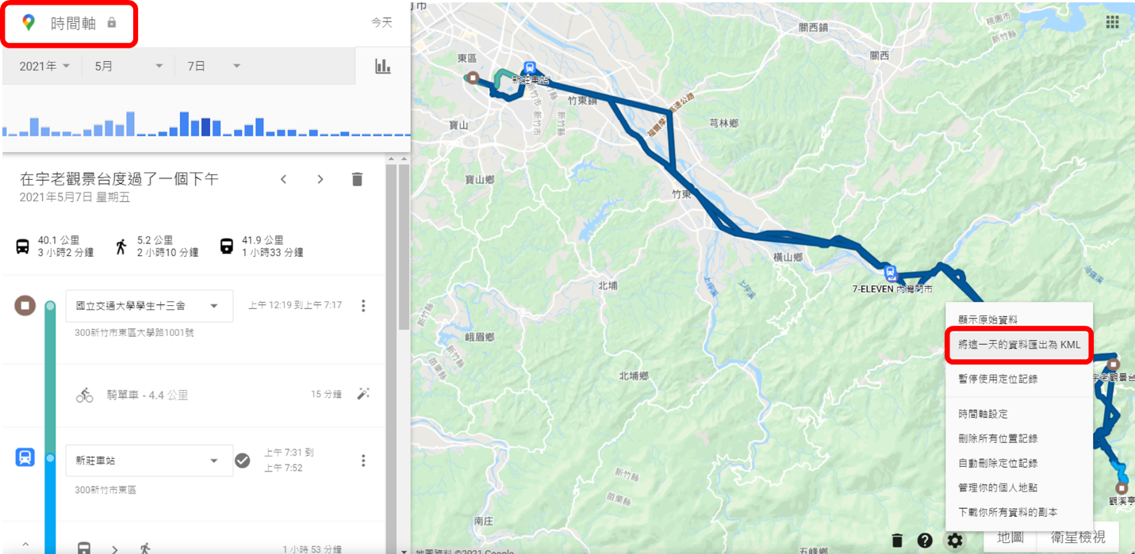
Export Spatial Data
Spatial Data Format
KML（.kml）
Google Map Timeline

Slide 46
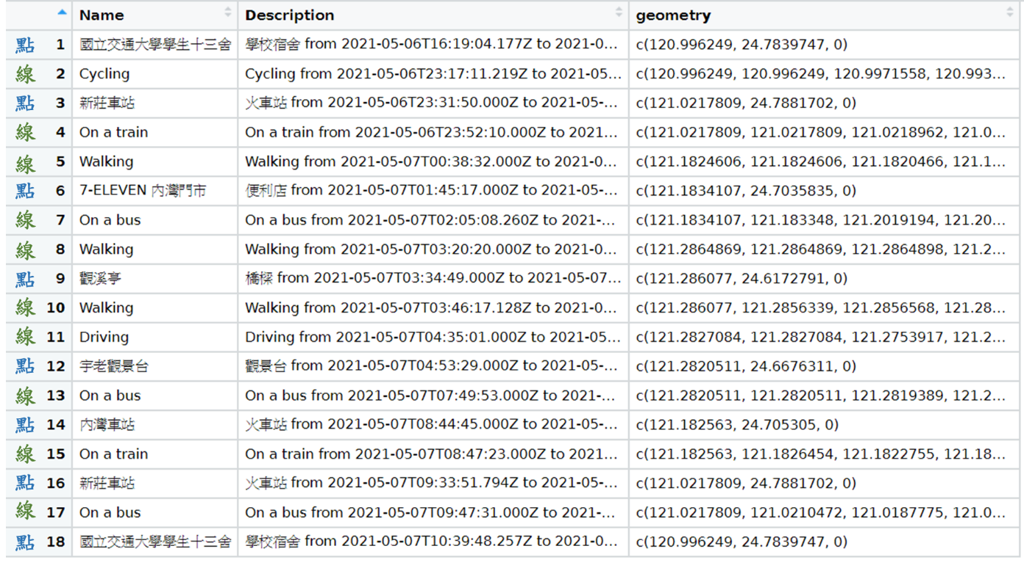
Export Spatial Data
Spatial Data Format
KML（.kml）
Google Map Timeline

Slide 47
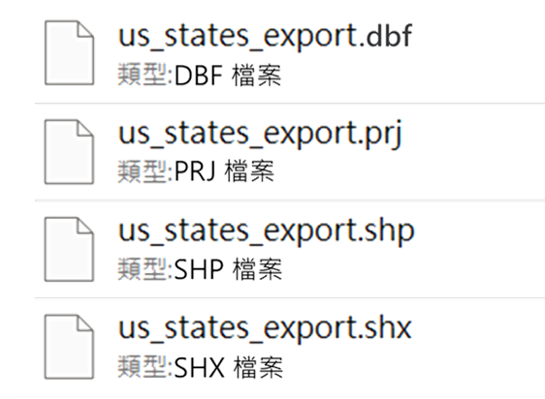
Export Spatial Data
Export the Data
write_sf(DATA, "./FILE/NAME.FORMAT")
# 輸出us_states資料
write_sf(us_states, "./us_states_export.shp")
==========================================================
## Warning in abbreviate_shapefile_names(obj):
## Field names abbreviated for ESRI Shapefile driver

Slide 48
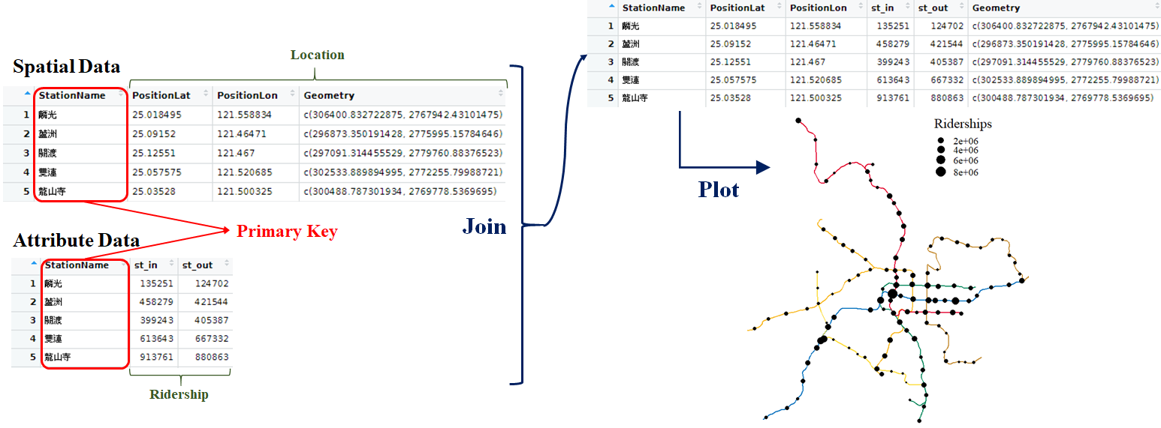
Join Attributes
Relational database

Slide 49
Join Attributes
Join Data
left_join(GEODATA, ATTDATA, by=c("col1"="col2"))
Spatial Data
Attribute Data
GEODATA
ATTDATA
GEOID | Lat | Lon | Geometry
… | … | … | …
ATTID | ATT1 | Att2
… | … | …
Primary key
left_join(geo, att, by=c("GEOID"="ATTID"))

Slide 50

Join Attributes
# read US COVID 19 Data
us_covid=read.csv("https://data.humdata.org/hxlproxy/api/data-preview.csv?url=https%3A%2F%2Fraw.githubusercontent.com%2Fnytimes%2Fcovid-19-data%2Fmaster%2Fus-states.csv&filename=us-states.csv")
# view us_covid
head(us_covid)
## date state fips cases deaths
## 1 2020-01-21 Washington 53 1 0
## 2 2020-01-22 Washington 53 1 0
## 3 2020-01-23 Washington 53 1 0
## 4 2020-01-24 Illinois 17 1 0
## 5 2020-01-24 Washington 53 1 0
## 6 2020-01-25 California 6 1 0
Covid-19 Data in US
Read Data from Open Sources

Slide 51
Join Attributes
# the accumulative statistics in 2022-10-07
us_covid=filter(us_covid, date=="2022-10-07")
# view us_covid
head(us_covid)
## date state fips cases deaths
1 2022-10-07 Alabama 1 1526381 20473
2 2022-10-07 Alaska 2 305125 1350
3 2022-10-07 American Samoa 60 8250 34
4 2022-10-07 Arizona 4 2275235 31406
5 2022-10-07 Arkansas 5 953681 12276
6 2022-10-07 California 6 11290991 96348
Covid-19 Data in US
Filter data by dates

Slide 52
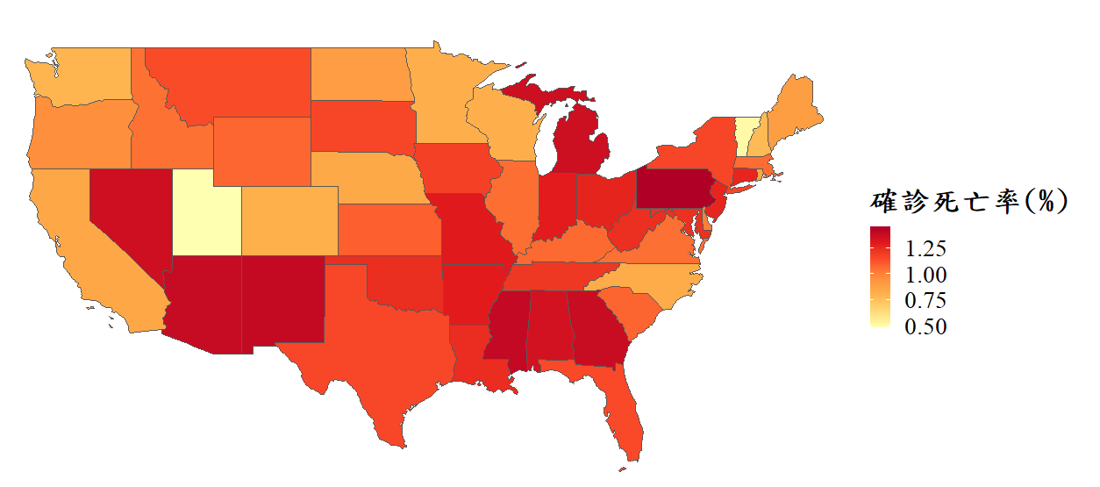
Join Attributes
Covid-19 Data in US
Join data
# Join spatial data and attribute data
us_states_covid=left_join(us_states, us_covid, by=c("NAME"="state"))
# Add new column of death rate
us_states_covid$death_rate=us_states_covid$deaths/us_states_covid$cases

